Slide 1
Data Visualization: Branching out Beyond Excel

Slide 2
Getting to this point
“Big Data” is more accessible
Everyone likes “pretty”
Tools are readily available
Data visualization is “hot”
Notes:
Kim and I both have many years of experience working with data, but we hadn’t done much with data in the visual realm. No escaping the fact that data visualization is hot, and visualization may end up defining what “Big Data” is really all about.
We’ve both previously created graphs in Excel, which I’m sure many of you have as well, but wanted to move beyond that into interactive “data discovery” tools.

Slide 3
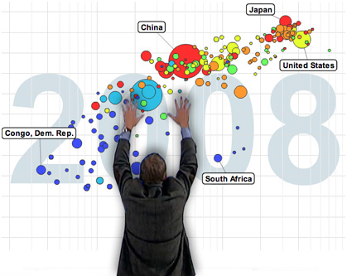
The Power of Data Visualization
…with a camera crew
http://www.gapminder.org/videos/200-years-that-changed-the-world-bbc/
Notes:
Has anyone seen Hans Rosling’s video called “200 years, 200 countries, 4 minutes” that was aired originally on the BBC?
Data visualization’s potential is great.
Unfortunately, we don’t have a camera crew like Hans.
Is a dashboard our story telling tool?
Visual and the tools to explore are much harder to do.

Slide 4
The Power of Data Visualization
…a recipe for the rest of us.
Start with:
Good data
Visualization software (free or otherwise)
Optionally add:
Data analyst
Designer
Webmaster
Season heavily with:
Willingness to experiment
Patience
Common sense
Notes:
Tableau – better & no code. No webmaster needed(!)?

Slide 5
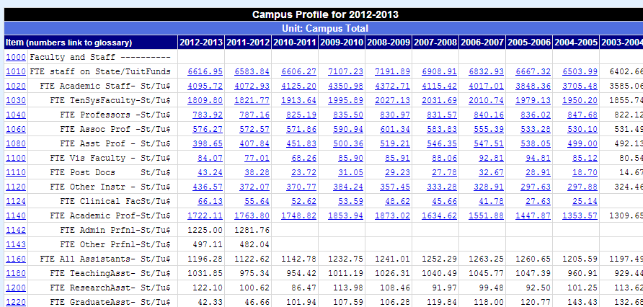
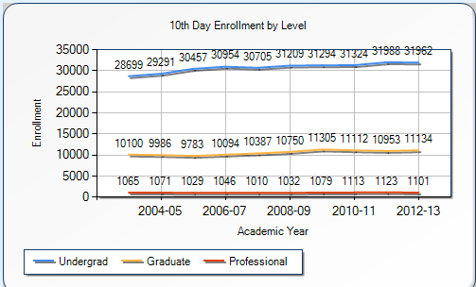
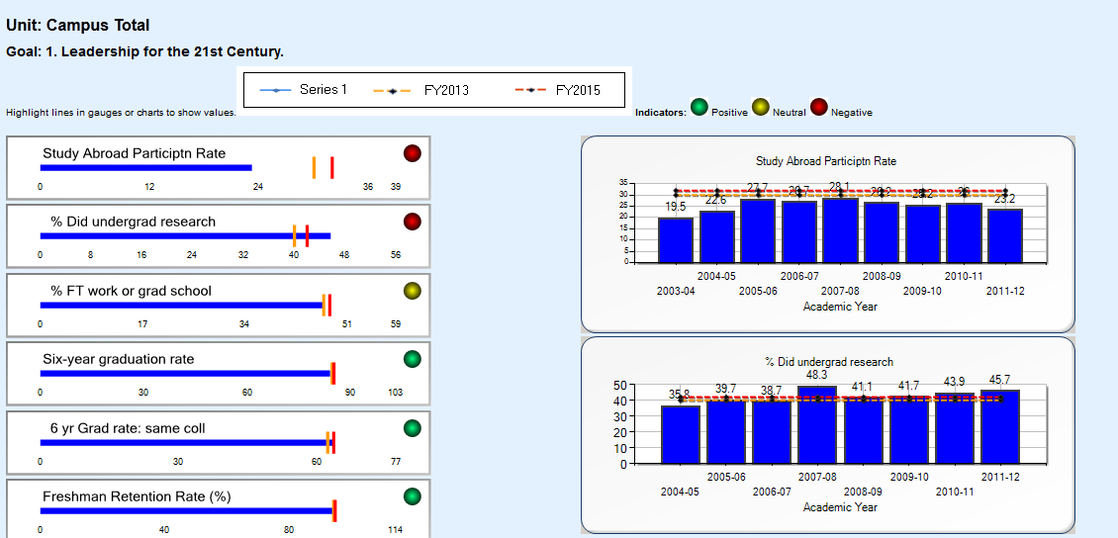
DMI Campus Profile
http://www.dmi.illinois.edu/cp/
Notes:
Quick plug for my unit, DMI, Division of Management Information. Taken from DMI website.
A conservative and steady approach based on solid data and expertise with visuals only added as enhancements to base data.
Also worked with Stig in Provost’s Office during last Strategic Planning process to create our “Strategic” Profile
Visually shows how colleges are doing with goals and targets for various metrics. Very successful, still used by Provost’s Office & colleges today.

Slide 6
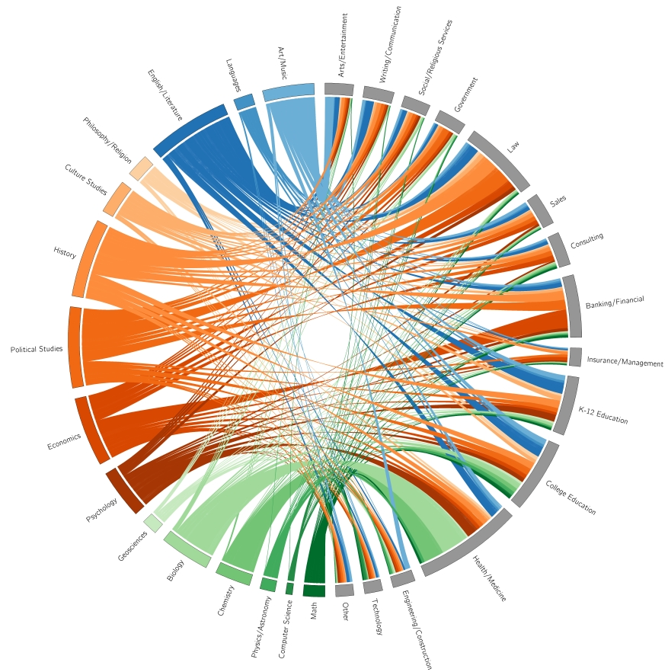
Williams College – Majors and Career Paths
Notes:
Created by undergrad students at Williams College in Massachusetts.
Visualizes career paths of over 15,000 Williams graduates, with majors on left, careers on right.
Pretty, somewhat hard to follow.
This recently made the rounds at the Provost’s Office.
Fortunately, allows interactive filtering.

Slide 7
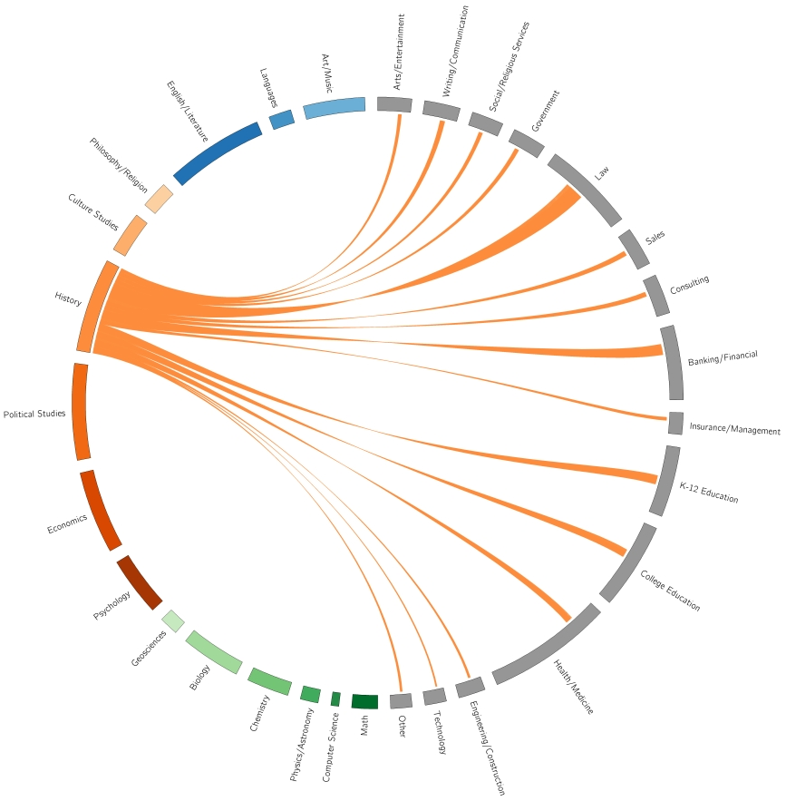
Williams College – Majors and Career paths – History only
Notes:
Ah, that’s better! History majors only.
Wide variety of fields. Mostly law, but quite a few into Banking/Financial and also K-12 Education.
Setting the “pretty bar” very high! Not as concerned with “function.”
We want to create visualizations people will return to again and again.
Just like webpages that were heavy on “flash” attracted early attention, but interest faded.

Slide 8
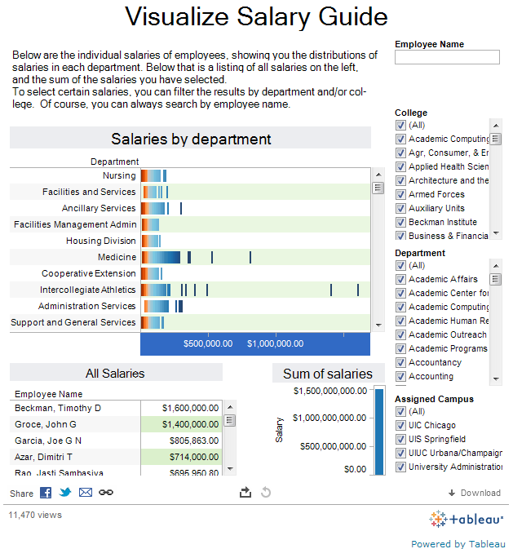
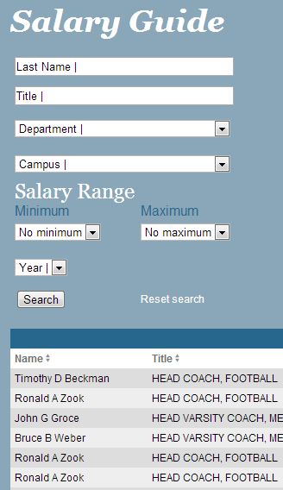
Daily Illini
http://www.dailyillini.com/salary_guide/salary_2012/ http://data.illinimedia.com/salaries
Notes:
Here’s another one created by undergrad students, this time at the Daily Illini.
This one sets the bar low.
Visualization of the Salary Guide, which is unfortunately hard to make heads or tails of. Table is easier to use.
Not trying to pick on Daily Illini. Dashboards are hard!
Could a webmaster/designer have helped? The advantage is a chance for user to explore, however interface colludes.

Slide 9
DataViz Show-and-Tell
As promised, “compelling visualizations of actual U of I data”
All visualizations and associated data at: http://go.illinois.edu/dataviz

Slide 10
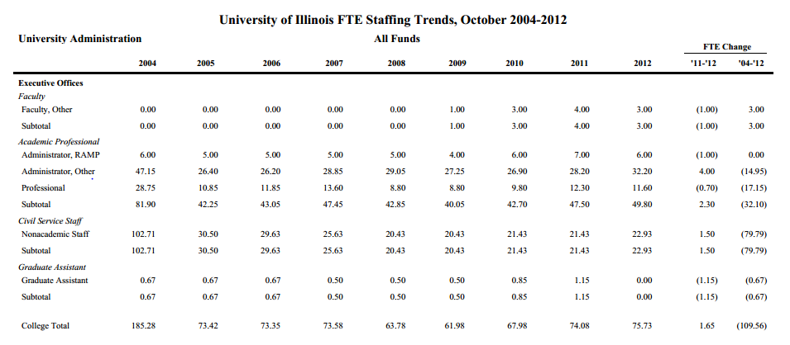
An HR Data Makeover
Notes:
Something more useful: HR Data Makeover.
Take data in a tabular format (much like the DI Salary Guide), in this case over 200 pages worth of PDF’s from Planning & Budgeting, and turn it into…

Slide 11
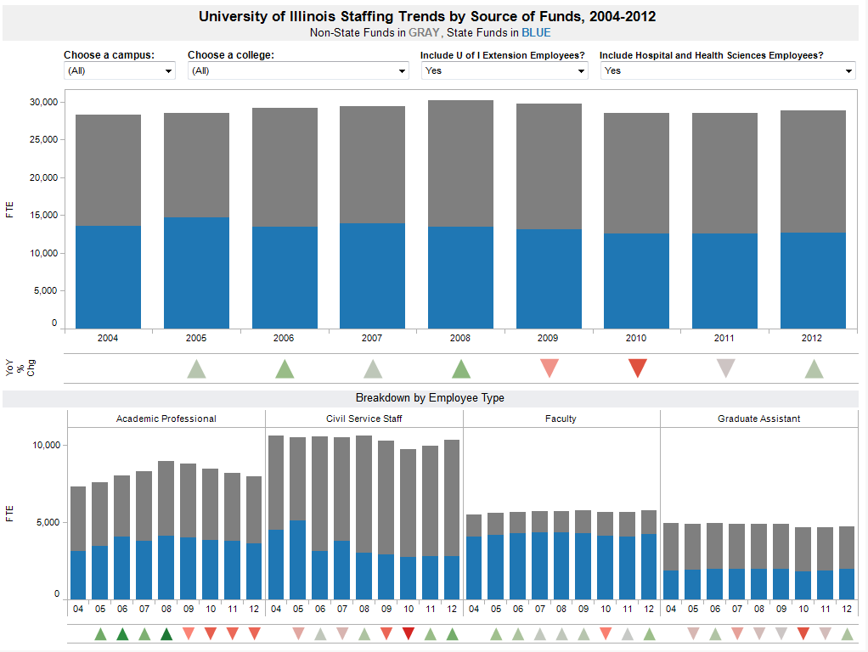
An HR Data Makeover
Notes:
Put this dashboard together for a talk last week, striving for functionality rather than “pretty.”
This is actually “version 2” thanks to some advice from Webmaster Julie McMahon. Still have lots of ideas as to ways this can be improved.
Open in Tableau.
This may look like a web page, but it’s actually a Tableau dashboard.
Tableau dashboards and worksheets can be published to web server or embedded within web pages. No HTML/CSS/.NET; no code!
What is Tableau? An extremely popular “next generation” data visualization tool.
“Free” with a catch… have to put your data in Tableau’s cloud service. If you want to keep your data private, $1500/person.
Don’t need a database at all! Text/Excel files fine! Almost every database under the sun is supported natively though.

Slide 12
“Reimagining”
Goal: take a visualization familiar with and improve upon it
Notes:
The next challenge: take data already in a visual format and improve upon it.

Slide 13
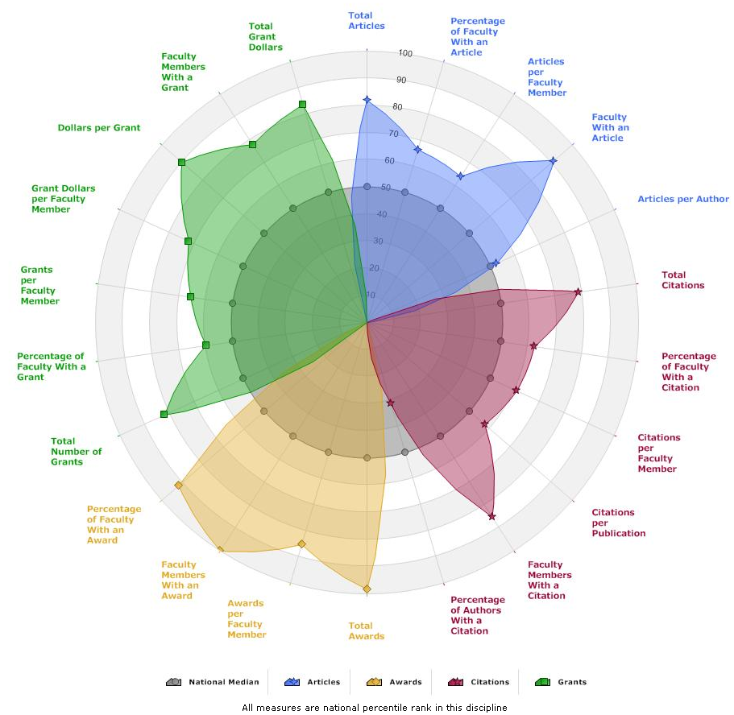
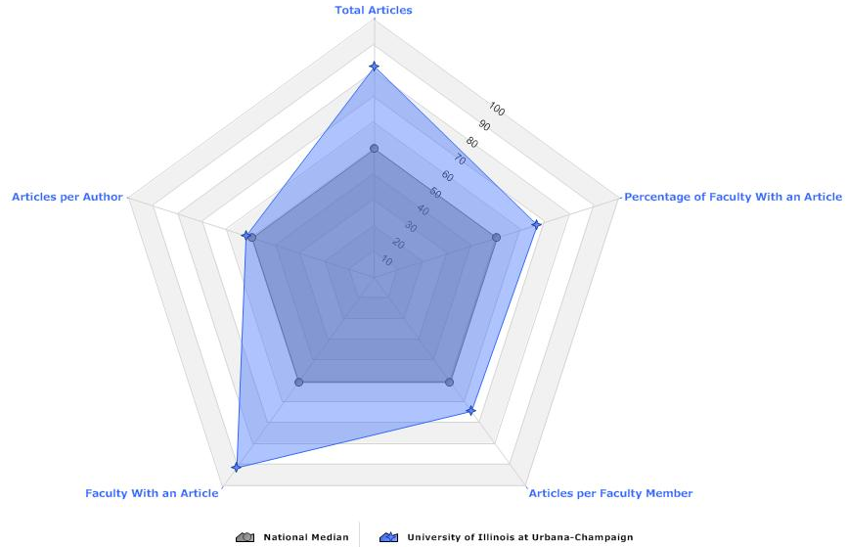
Academic Analytics
“Flower”
Radar
Notes:
I chose Academic Analytics. Anyone heard of it? On the “flower” chart on the left, looking at 4 different categories of faculty metrics by national percentile rank for a particular academic department. Happens to be Library & Information Science, seems appropriate since we’re in their building. On the “radar” chart on the right, looking at a single category, articles. Same data as on the left in blue.
Pretty, but how functional is it?
Can you easily pick out the strengths vs. weaknesses? (Radar, yes; flower, not as much) How do you read actual values on either chart?
What if you wanted to compare our program to programs at other schools? How can you do this with either one? Overlapping areas.

Slide 14
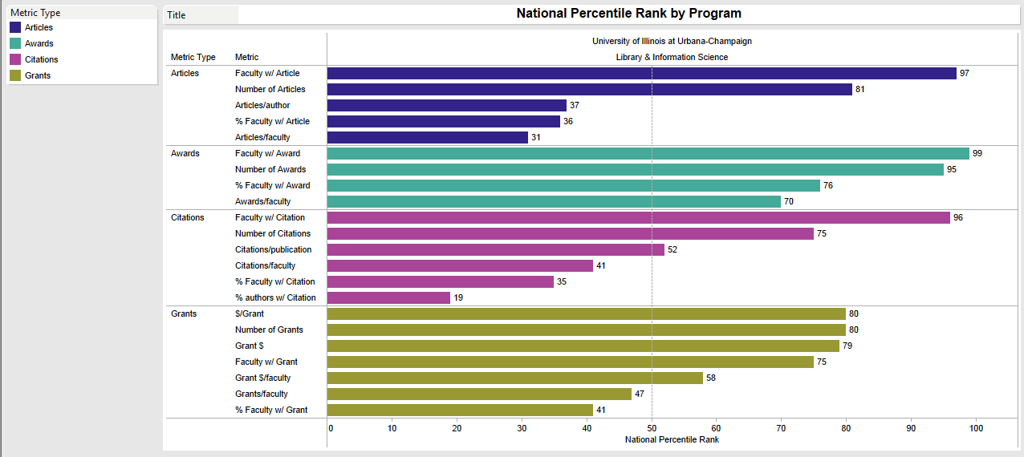
Academic Analytics “Reimagined”
Notes:
Replaces the flower and radar
NOTE: this is made up data

Slide 15
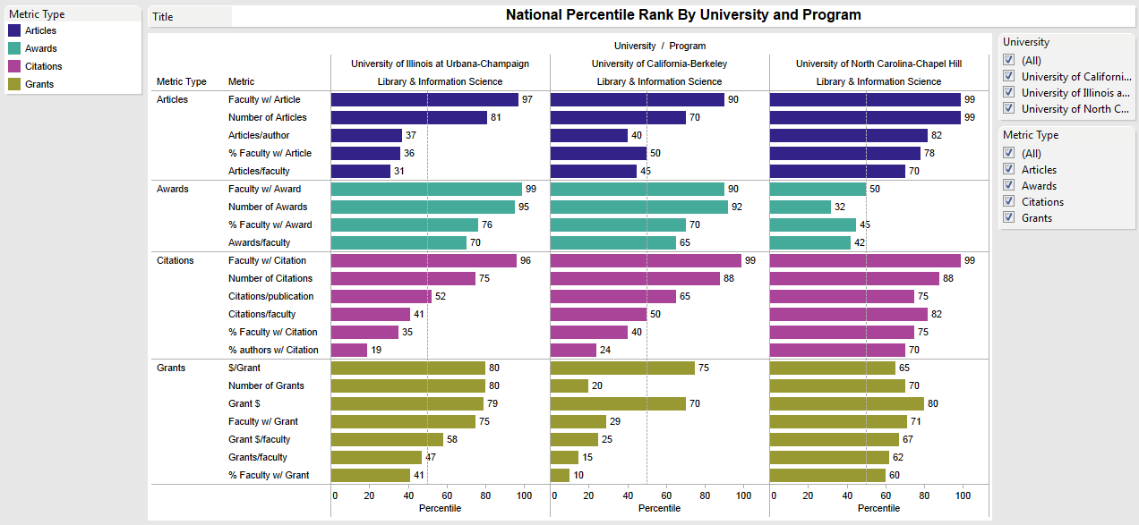
Academic Analytics “Reimagined”
Notes:
Goes beyond the flower and radar to facilitate comparisons among multiple schools; interactivity NOTE: this is made up data

Slide 16
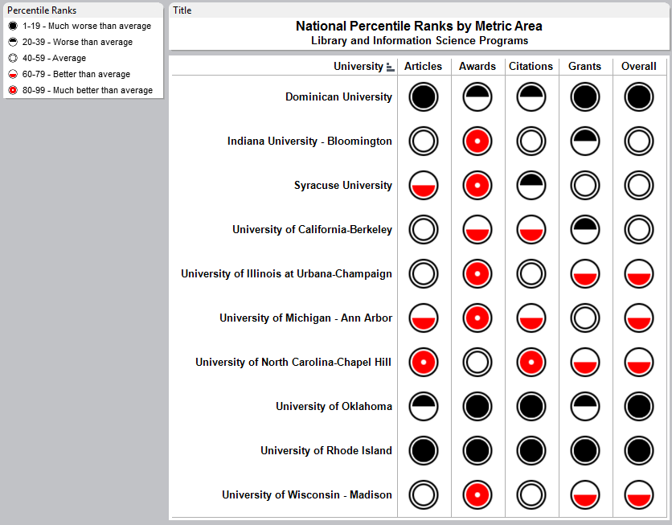
Academic Analytics “Reimagined”
Notes:
Anyone remember Consumer Reports magazine? (still have a website)
NOTE: this is made up data

Slide 17
“Big” Data
46 years of international student enrollment data at UIUC
Source: http://www.dmi.illinois.edu/stuenr/#foreign
The tool: Tableau
Notes:
Next part of the journey: “Big” Data. Did anyone catch Jon Orwant yesterday? Google Research: Real “big” data.
46 years of data is not “big” data (70,000 rows), but it sure is more than you want to look at in table form!

Slide 18
Maps
Country data: natural place to start
Add additional dimensions to bring out stories in data
Male vs. Female
Undergrad vs. Grad
Move from Choropleth to Colored Bubbles
Notes:
Since our dataset contains country data, maps are a natural place to start.

Slide 19
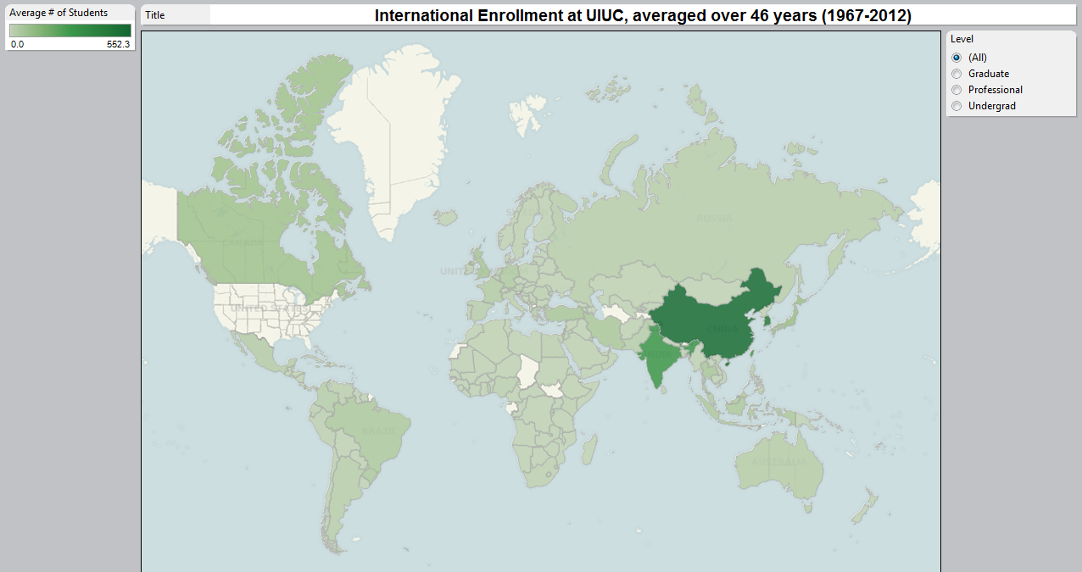
Notes:
Looking at 46 years worth of International Student Enrollment at UIUC. I’ve taken enrollment over all of those years, calculated average per country, and plotted it in green, with darker green representing higher international enrollment. Sometimes called Choropleth Map. -A few things to point out -China and India stick out; all others hard to distinguish from each other in terms of enrollment. -Covered most of the map over those 46 years: small island nations, sub-saharan africa, a few of the “stans” became independent in early 1990’s (Tajikistan, Turkmenistan).
-All of the “missing” countries have very low nationwide enrollment. Gabon is one that sticks out a bit because its enrollment is highest among the “missing” countries, with their nationwide enrollment going from 74 in 1999 to 402 in 2011. May represent an opportunity for UIUC.

Slide 20
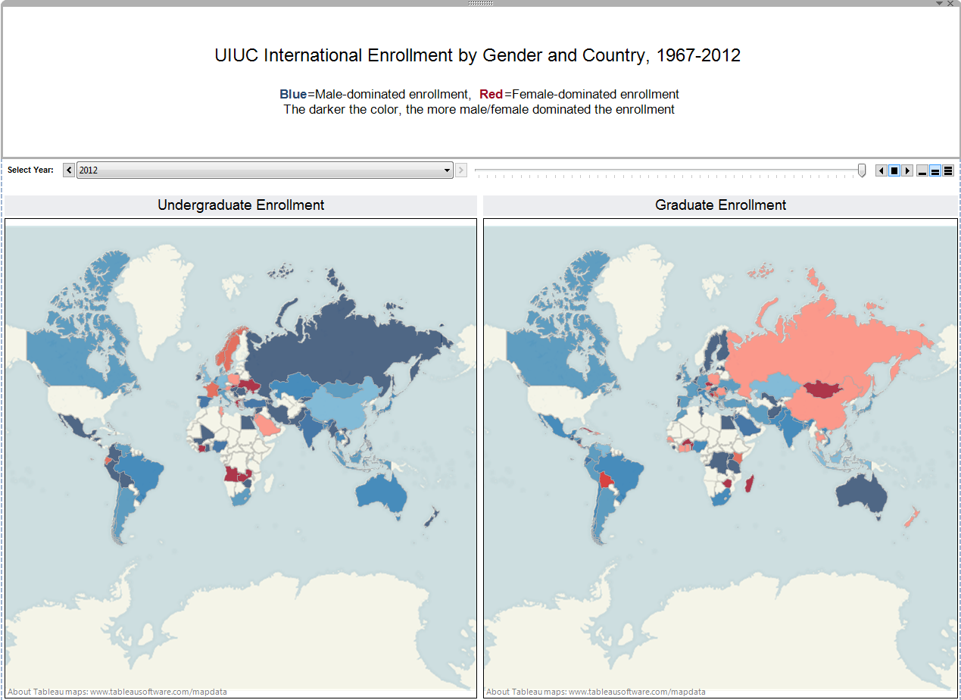
Notes:
What if we want to dig deeper and start to look at male vs. female for both undergrad and grad? -Spent a lot of time putting together this dashboard, thinking I was really clever -It’s pretty! Can probably tell which color is male and which is female. -Obvious that more female enrollment on grad side that on undergrad side, at least in 2012. -One problem: no representation of number of students, only percentages of male vs. female enrollment. -Distortion: Russia takes up a lot of space on map, but mouse over and only 24 grad students. -Mongolia really sticks out: only 1 student.

Slide 21
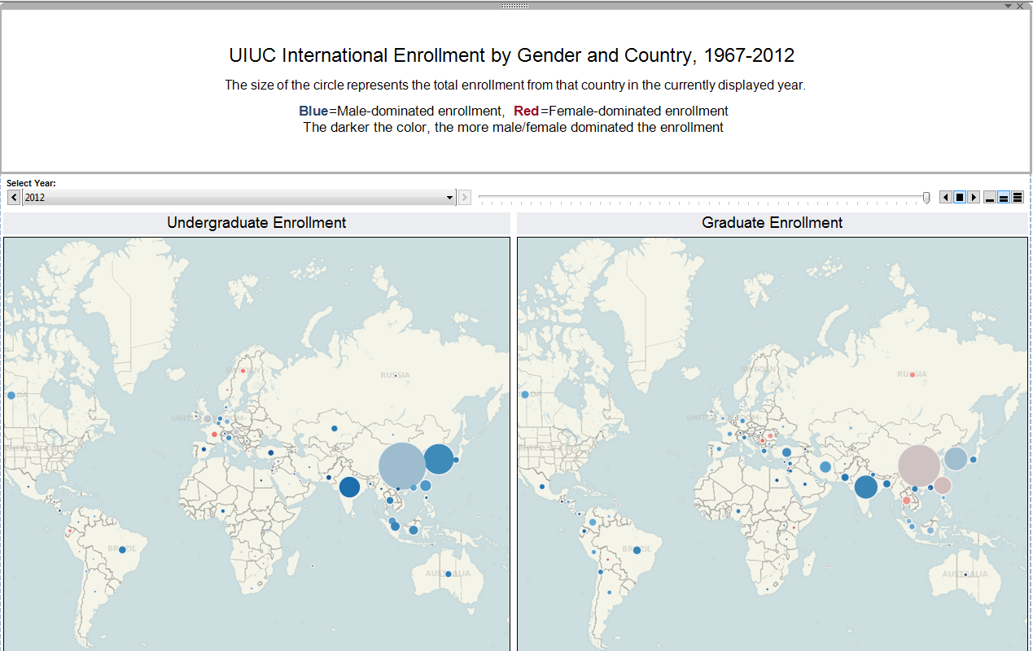
Notes:
Move away from Choropleth, try colored bubbles on map instead. -Magnitude and male/female ratio represented, although not as visually pleasing as previous map. -One other advantage: animation! Play it: did you see China go from nothing to dominating map on Undergrad side? -Fun to animate, but actually pretty hard to show changes over time. -Look at 2000 vs. 2012 -2000: Undergrad enrollment very low compared to Grad; China biggest circle; mouse-over: 649, 62% male -2012: Step through; see undergrad take off, grad grows as well; China undergrad, mouse-over, 2,139, 54% male
Problem remains: longer term trends hard to see

Slide 22
Area Charts
Dashboard #1: Single region/country at a time
Dashboard #2: All regions/countries at a time

Slide 23
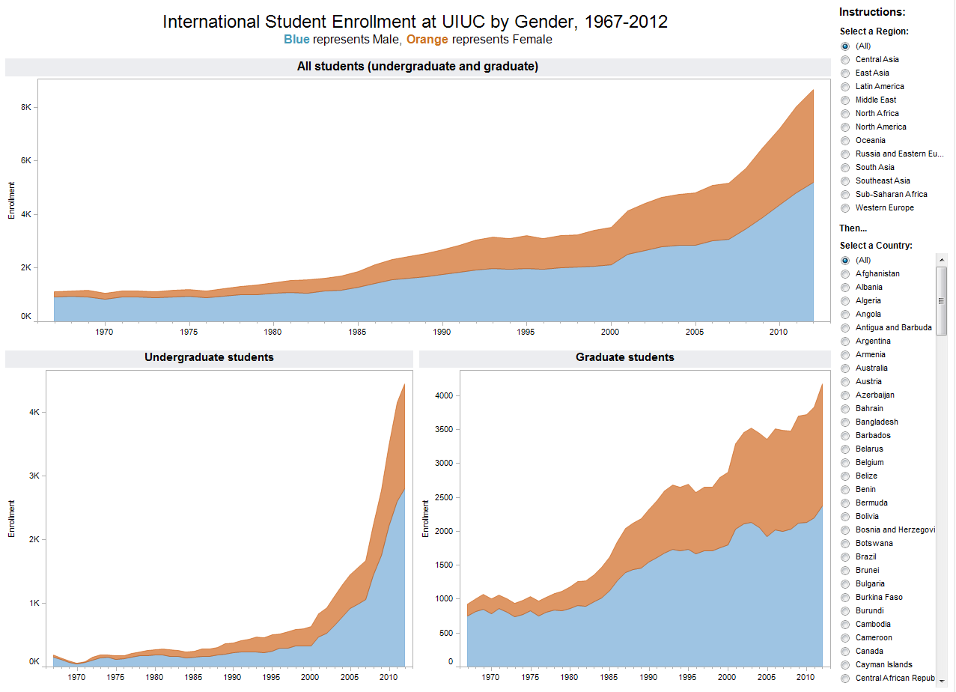
Notes:
Dashboard #1: totals at top, breakout at bottom. Yep: Orange and Blue; Orange – female; Blue – male
-Not dissimilar to staffing dashboard we looked at earlier, but this time lines rather than bars since we have lots more years worth of data. If you’re not familiar with area charts, basically a hybrid of stacked bar and line; nice way to see parts of a whole over time.
-People often want to use pie charts for parts of whole comparison, but 46 years worth of pies hard to read (sounds tasty though). Right now, looking at all countries and all regions. -Can see large spike in enrollment from 2007-2012, looks like most of growth coming on male side. -Look below, looks like male undergrad in particular has grown quickly.
Anyone have a region and/or country they want to look at? This is nice if you have a particular region or country in mind, but what if you see all regions/countries at once?

Slide 24
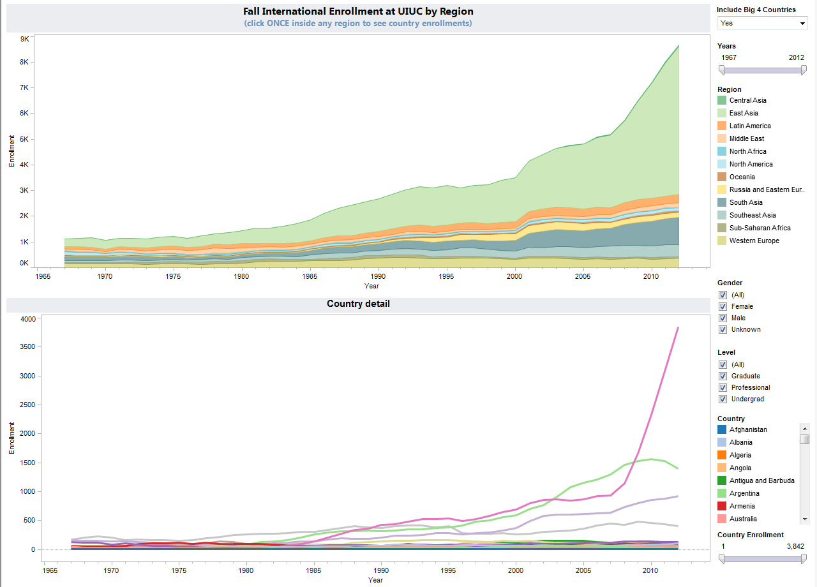
Notes:
Dashboard #2: regions at top, each color represents different region. Countries at bottom. -Harder to separate this out by Male/Female, Grad/Undergrad. -Added controls to allow filtering, but side-by-side comparisons difficult. -See right away East Asia dominating as Region, 4 countries dominating overall (mouse-over): China, South Korea, India, Taiwan -The “Big 4”
-Control at top allows you take out “big 4” -Allows you to see everything underneath the enrollment giants. -A lot less dramatic picture; still growth but not as rapid. -Country detail is an absolute mess. -Slider can help: Get rid of everything below 100 -See Japan rise in the 90’s, fall off considerably since then. -Turkey rise in early 2000’s, drop off a bit. -See brown line at bottom: Iran. Click on to highlight; see spike in 1979 -Huge drop since then but then rising throughout 2000’s to near original peak. -Put “Big 4” back in, adjust slider. Click on a region. -Anyone want to pick one? -See region highlighted; see county detail below. -Interactivity encourages exploration; often difficult to cut through the details.

Slide 25
Bump Chart
Rank by Region
Pretty good!
Rank by Country
First 4 ok, then chaos
Notes:
Let’s go back up and take a slightly higher level view of things.

Slide 26
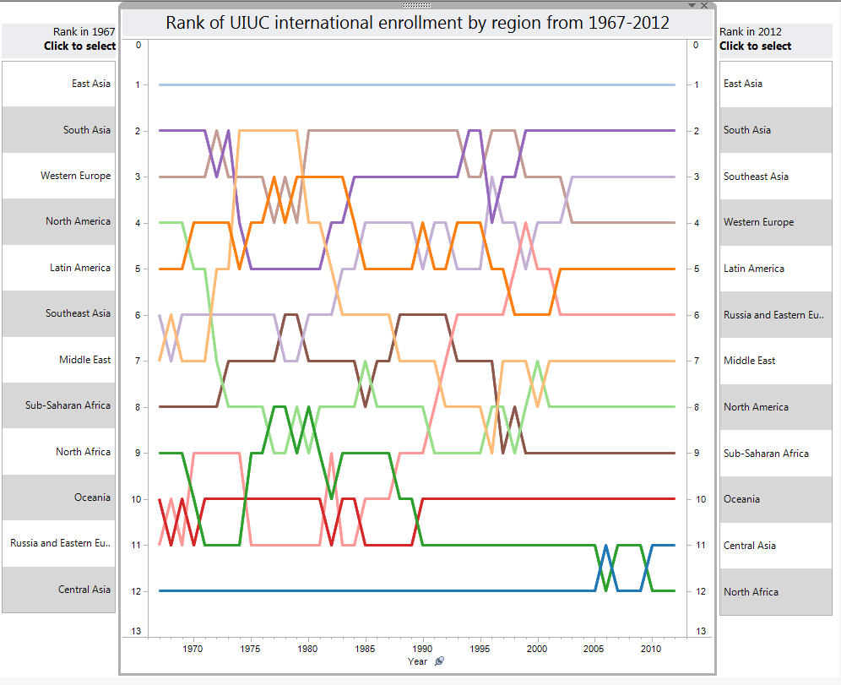
Notes:
This is called a bump chart, and it’s showing us how the regions fall out in terms of rankings. Higher rank, more students. -1967 rank is on the left, 2012 rank is on the right. -See how regions change, or don’t change in case of East Asia, over time. -Click on a particular region, let’s say “Middle East”, and you can see how it started ranked 7th, jumped all the way to 2nd, and then crashed to 9th. Recovered slightly to 7th in 2012. Any ideas why? This is promising: let’s drill down to country level and do the same thing.

Slide 27
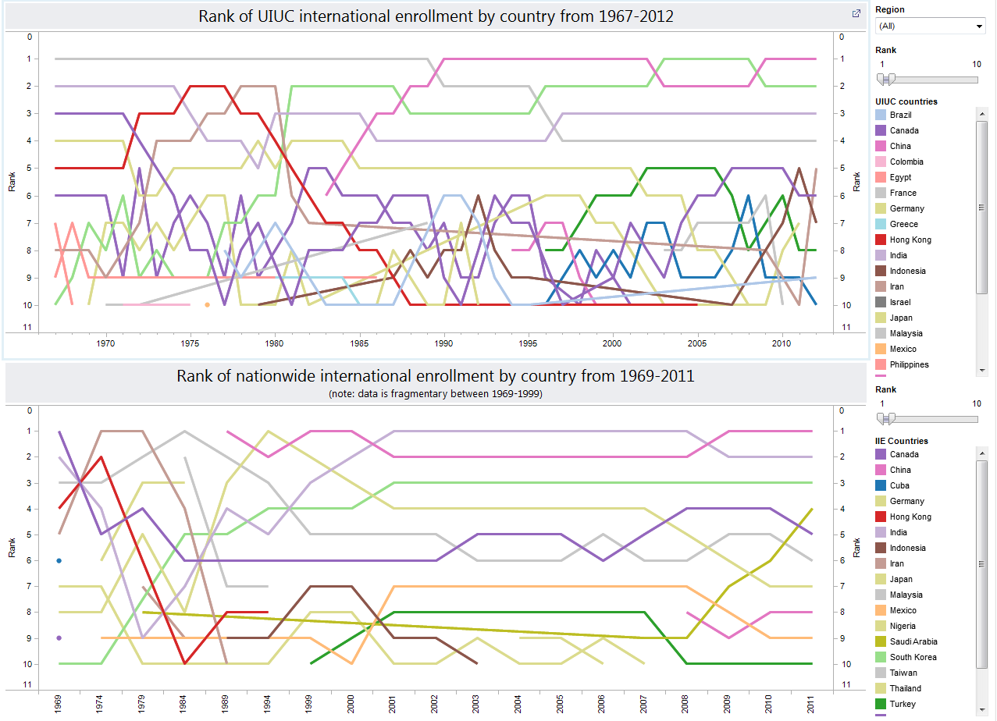
Notes:
Top 10 countries by enrollment rank. -Bit of a preview: data mash-up, shows UIUC country rank at top, Nationwide country rank at bottom. -Can see “the big 4” at the top, but then basically descends into chaos. -Little less chaotic at the national level. -Look at gold line: Saudi Arabia: starts not ranked in top 10 at all, pops out in 1979, jumps from 9th to 4th from 2008 to 2011. -Where is Saudi Arabia at top? Nowhere to be found. Starting to find some stories in the data.
Since these simple lines seemed helpful, let’s keep pushing in that direction a bit and see what we might find. One flaw of this chart: rank, but not magnitude.

Slide 28
Trellis (“Small Multiples”)
Individual layers of Area Chart
Strategically exclude to highlight trends
Notes:
Also sometimes called “small multiples”. Elegance and simplicity.
Ordered from greatest to least enrollment in most recent year, placed in close proximity in a “trellis” or table of charts to allow comparison. Takes us back to our original area chart of male vs. female, but allows us to deconstruct it into its component layers.
Can view as many or as few layers at a time as you want (can even view single layer).

Slide 29
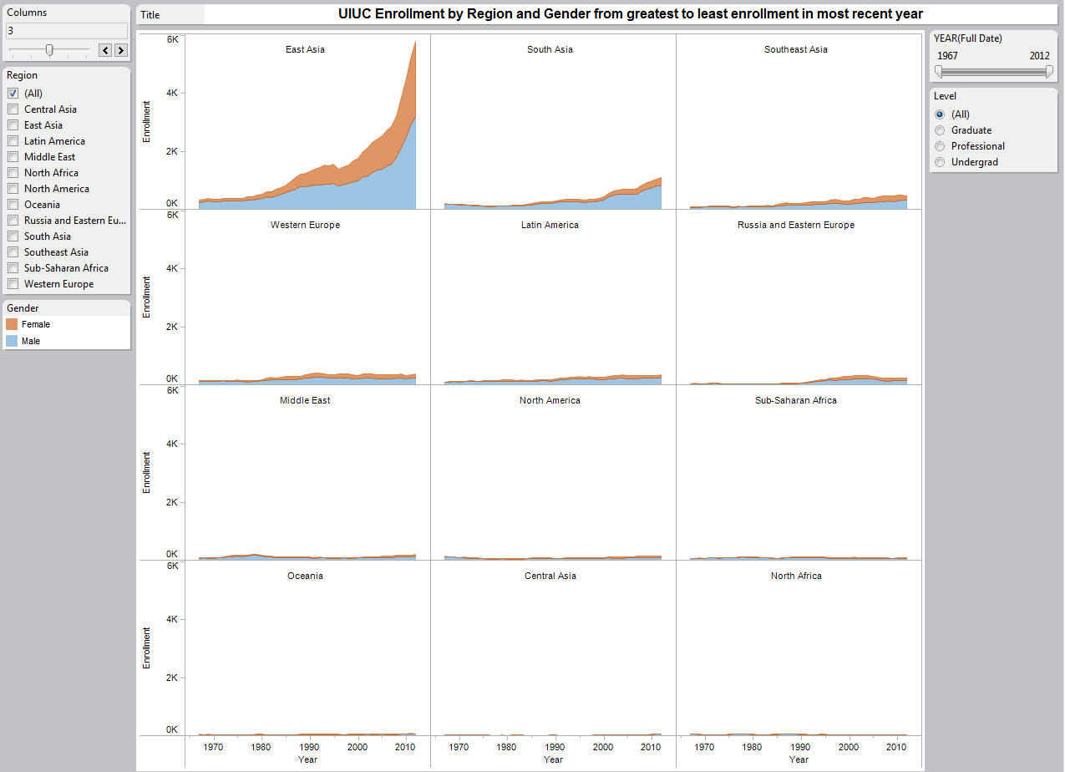
Notes:
East Asia dominating display

Slide 30
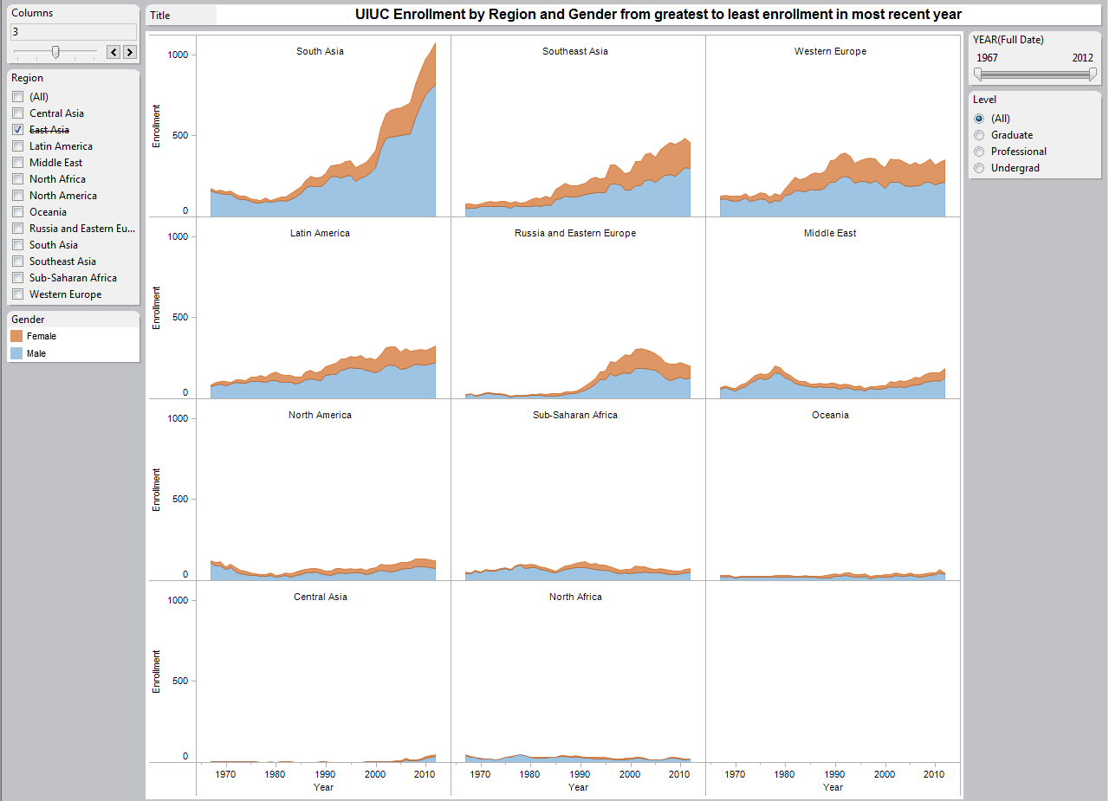
Notes:
Exclude East Asia -See large upward trend in South Asia starting in Mid-90’s; growth mostly on male side.
Let’s see if this type of display works better for country-level details.

Slide 31
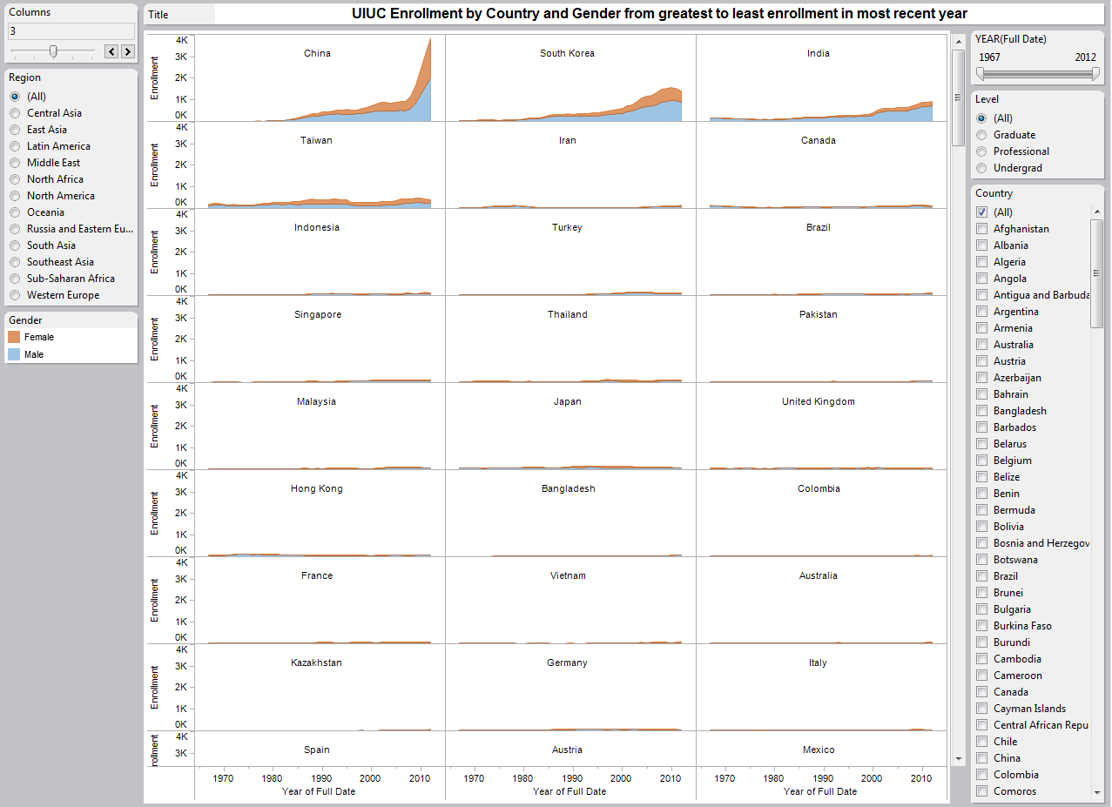
Notes:
Yes, much better than bump chart! Remember, ordered from greatest to least enrollment.
-Since we both Iran and Saudi Arabia were interesting earlier, let’s choose Middle East. -Iran’s trend over time is very clear, easily see male vs. female trends within as well. -Exclude Iran: other countries trends more evident. -Saudi Arabia comes in 3rd behind Iran and Lebanon, but actual number very low: 3 female, 10 male. Next logical step: compare with national trends.

Slide 32
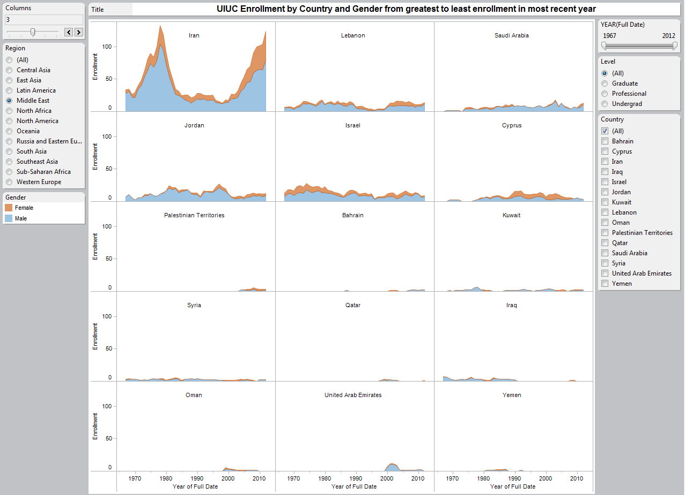
Notes:
Since both Iran and Saudi Arabia looked interesting earlier, let’s choose Middle East. -Iran’s trend over time is very clear, easily see male vs. female trends within as well. -Exclude Iran: other countries trends more evident. -Saudi Arabia comes in 3rd behind Iran and Lebanon, but actual number very low: 3 female, 10 male. Next logical step: compare with national trends.

Slide 33
UIUC Trends vs. Nationwide Trends
Country comparison
% of Nationwide total
Notes:
Mash up the data.

Slide 34
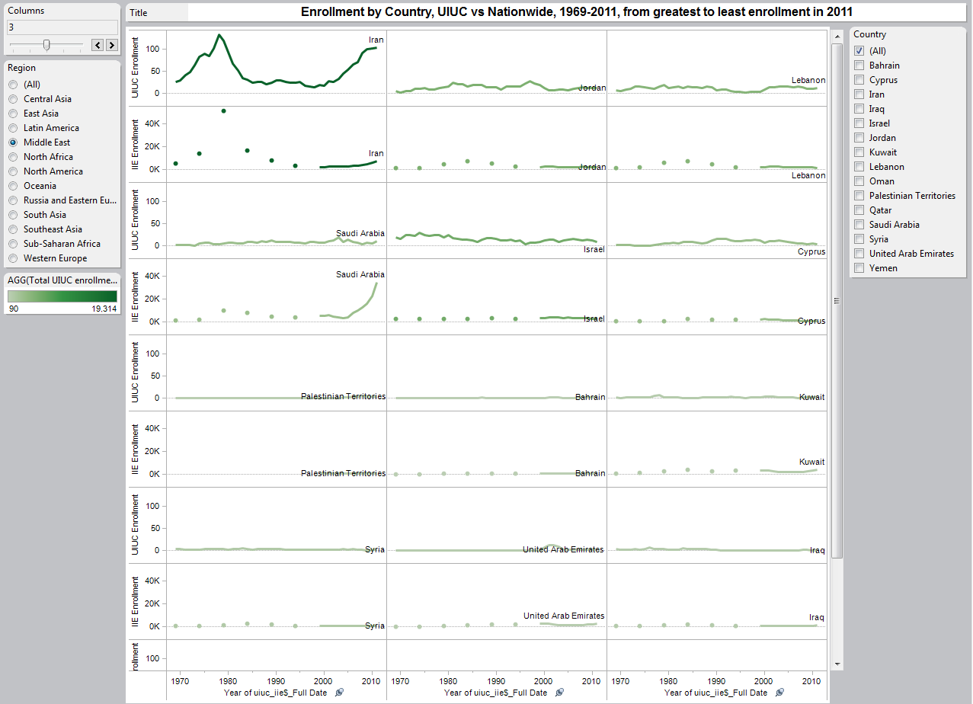
Notes:
Look at UIUC vs. Nationwide data; choose Middle East region. -UIUC on top, Nationwide just below
-Seeing limitations of national data: no male/female, undergrad/grad breakouts. Data fragmentary before 2000. -Iran dominating again, similar rise in late 70’s and crash throughout 80’s at national level, but UIUC rise much greater than national. -Exclude Iran. -See Jordan, Lebanon, as well, so we can see Saudi Arabia. -Seem to follow national trend fairly well until 2000’s when nationwide enrollment skyrockets and UIUC enrollment actually decreases.

Slide 35
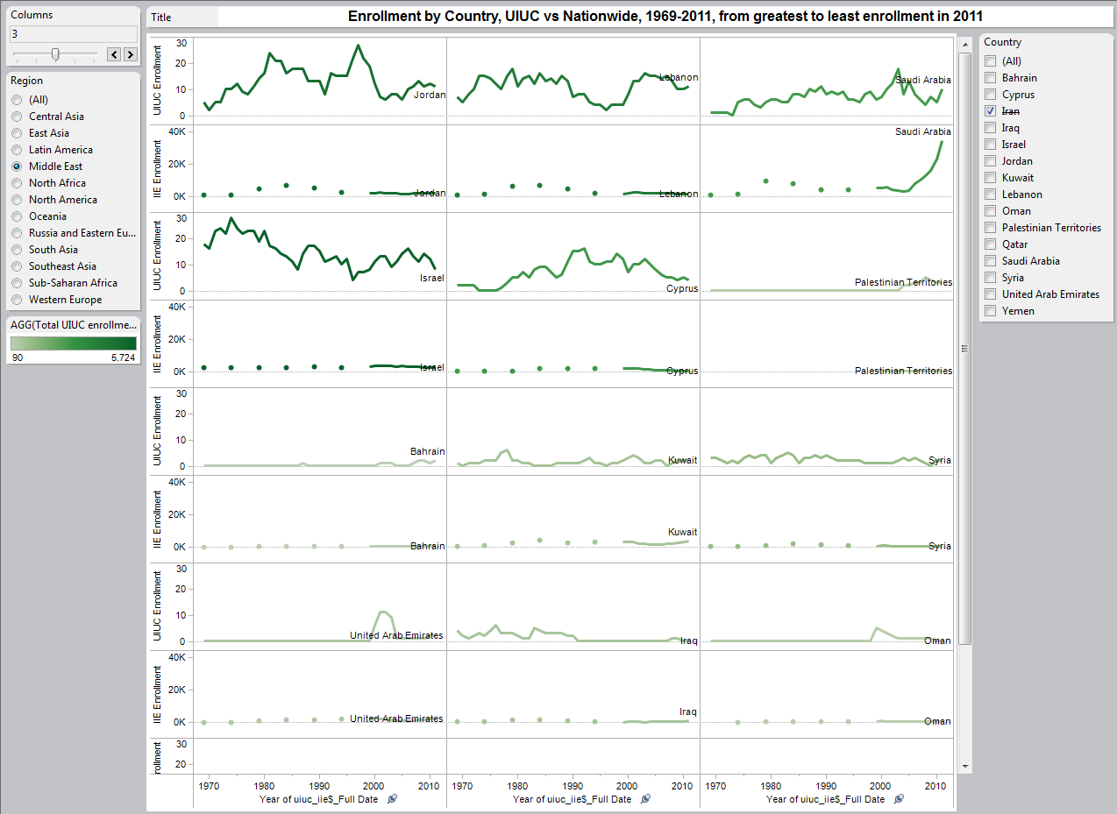
Notes:
Exclude Iran. -See Jordan, Lebanon, as well, so we can see Saudi Arabia. -Seem to follow national trend fairly well until 2000’s when nationwide enrollment skyrockets and UIUC enrollment actually decreases.

Slide 36
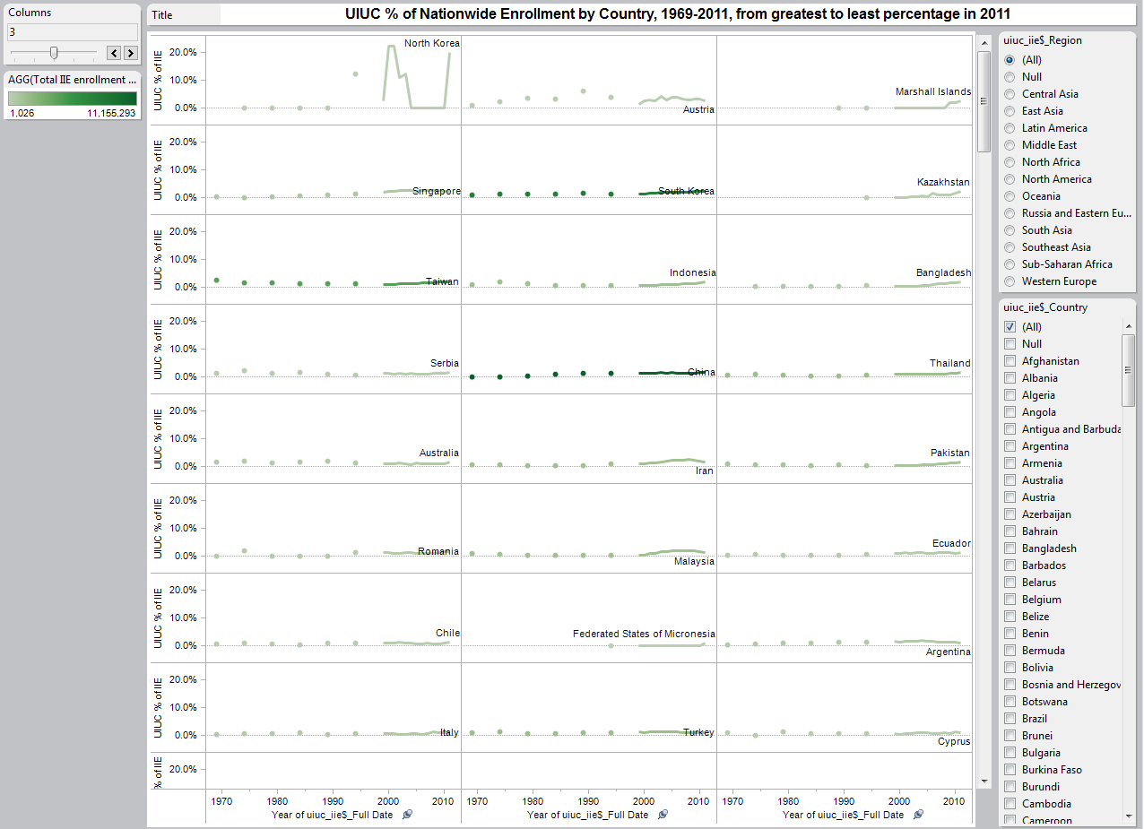
Notes:
One last way to compare UIUC vs. nationwide trends. -See what percentage UIUC makes up of nationwide enrollment by country. Ordered from greatest percent to least.
-Right away, see North Korea dominating chart. -UIUC enrollment comprises 20% of nationwide enrollment from North Korea? 27 students here from North Korea? Can’t be right.
-Data error. Visualization brought this out.

Slide 37
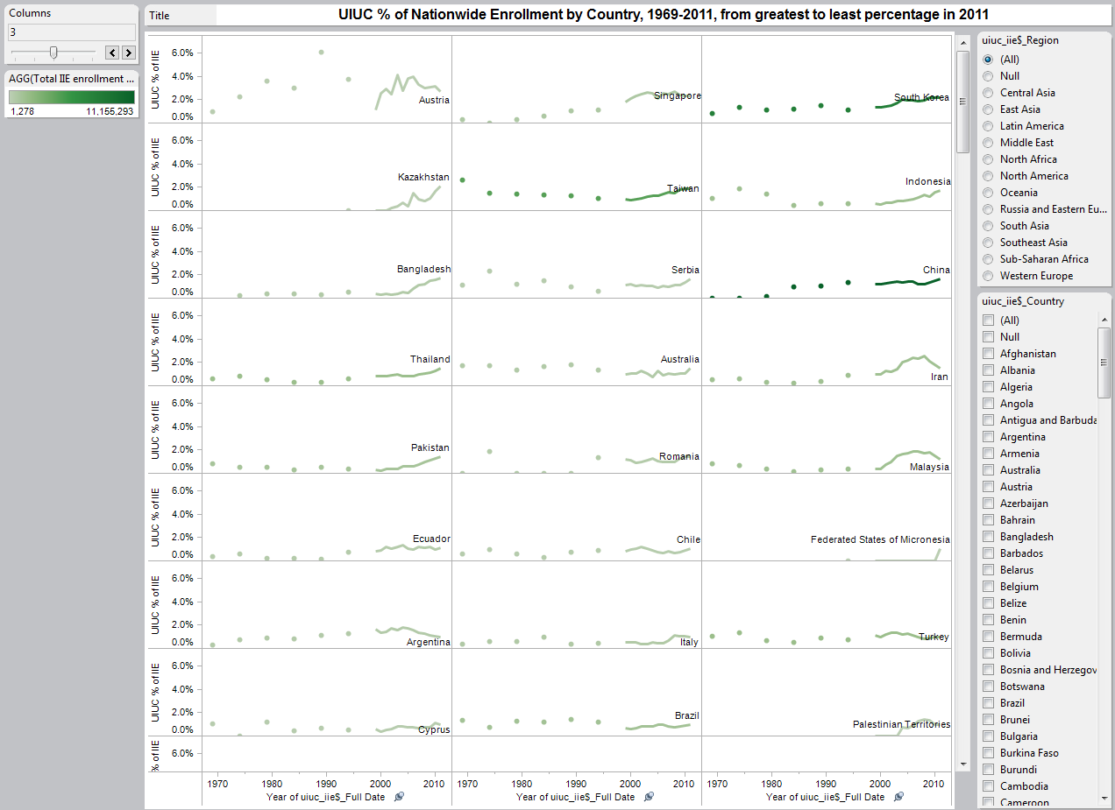
Notes:
Exclude North Korea; still can’t see much because small countries sometimes see wild fluctuations.
-Filter out nationwide enrollment less than 5,000. -A few interesting things: Proportionately, we receive more students from Austria than anywhere else. -Singapore 2nd place. Surprising! South Korea Third: not surprising. Kazakhstan 4th? Very surprising! -China, where recent enrollment explosion occurred, way down the list in 9th.

Slide 38
Animated Scatter Plot
Google Motion Charts
Google Docs (now Google Drive) + Google Charts
Play around on your own at http://go.illinois.edu/dataviz
Notes:
We’ve spent a lot of time looking at our data in Tableau. Sometimes it’s useful to try different visualization tools to find other stories.

Slide 39
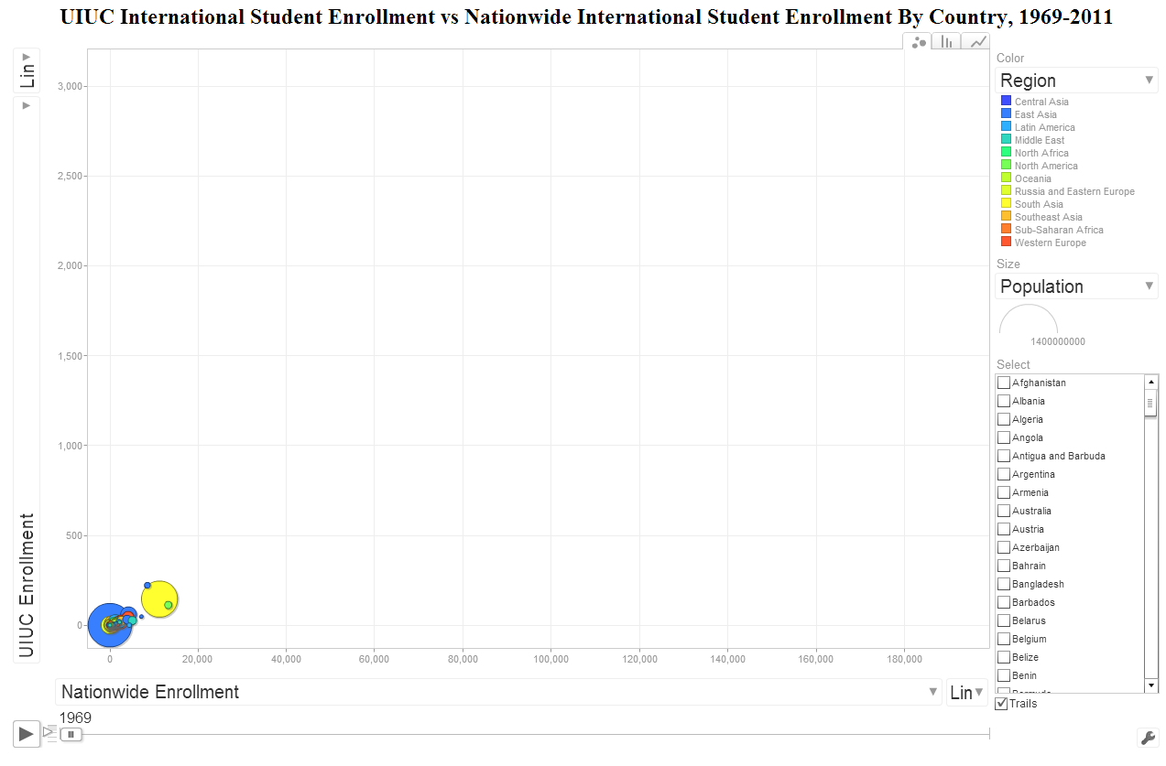
Notes:
You’re looking at a scatter plot, showing the same data we just looked at in Tableau: UIUC enrollment vs. Nationwide enrollment.
-UIUC enrollment is on the y-axis, nationwide enrollment is on the x-axis.
-If you’re not familiar with scatter plots, they are useful for allowing us to see outliers, and also to help us discover correlations. -We want to see if UIUC enrollment increases when nationwide enrollment increases, and conversely if UIUC enrollment decreases when nationwide enrollment decreases. -Bubbles represent countries; color of bubble represents region; size of bubble represents size of country population -If we mouseover leading enrollment countries on x-axis, we see they are India, Canada, and Taiwan. This is called a Google Motion Chart, and you’re about to find out why. -Same technology used by Hans Rosling in his health and wealth of countries over time video -See small light blue bubble breaking away from the pack? Freeze it: Iran. -Play it: look at Iran disappear into the cluster of small enrollment countries. -Look at 5 countries separating themselves from the rest during 80’s and 90’s. Freeze it: China, Japan, South Korea, India, and Taiwan. -Also notice that Japan is low on the y-axis, indicating lower enrollment at UIUC even though it’s almost farthest on x-axis. -Play it: early 2000’s, 3 countries break away: South Korea, China, and India. -Freeze it: Click on China, and watch what happens. -One interesting point: look who’s peeking out on bottom of x-axis at end in light blue: Saudi Arabia. 10 students at UIUC; 34,139 national.
We can go even a step further and try to use data visualization to help us make some predictions.
Following Hans Rosling’s lead, let’s look compare UIUC International Student Enrollment with various World Bank indicators.
-Starts out with GDP (current US$); let’s look at something a bit more interesting like Public spending on education as % of GDP. -Some of lowest spenders on education have highest enrollment; big blue circle=China. -Red circle bouncing around on x-axis in late 90’s-2000’s: Lesotho. 16% of GDP on education? Not leading to increase in intl enr. -Bubbles start popping when data disappears. -Doesn’t seem to be any real correlation here, but fun to watch.
Go to go.illinois.edu/dataviz after talk to play around with these World Bank indicators on your own.
Tableau can do something similar.

Slide 40
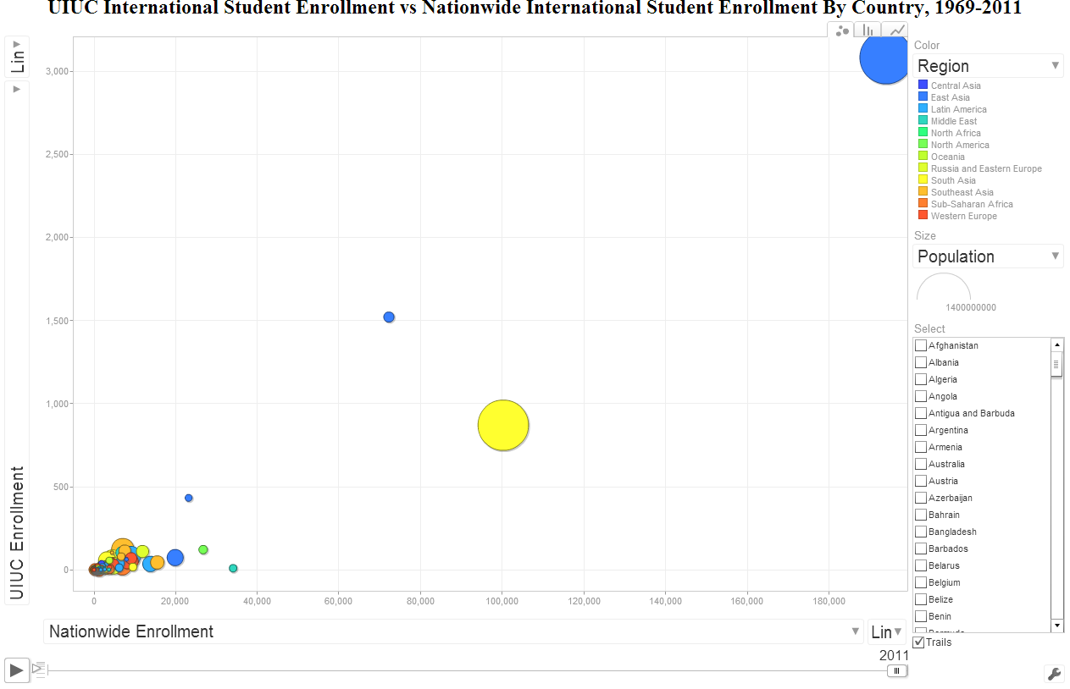
Notes:
Same technology used by Hans Rosling in his health and wealth of countries over time video -See small light blue bubble breaking away from the pack? Freeze it: Iran. -Play it: look at Iran disappear into the cluster of small enrollment countries. -Look at 5 countries separating themselves from the rest during 80’s and 90’s. Freeze it: China, Japan, South Korea, India, and Taiwan. -Also notice that Japan is low on the y-axis, indicating lower enrollment at UIUC even though it’s almost farthest on x-axis. -Play it: early 2000’s, 3 countries break away: South Korea, China, and India. -Freeze it: Click on China, and watch what happens. -One interesting point: look who’s peeking out on bottom of x-axis at end in light blue: Saudi Arabia. 10 students at UIUC; 34,139 national.
We can go even a step further and try to use data visualization to help us make some predictions.
Following Hans Rosling’s lead, let’s look compare UIUC International Student Enrollment with various World Bank indicators.
-Starts out with GDP (current US$); let’s look at something a bit more interesting like Public spending on education as % of GDP. -Some of lowest spenders on education have highest enrollment; big blue circle=China. -Red circle bouncing around on x-axis in late 90’s-2000’s: Lesotho. 16% of GDP on education? Not leading to increase in intl enr. -Bubbles start popping when data disappears. -Doesn’t seem to be any real correlation here, but fun to watch.
Go to go.illinois.edu/dataviz after talk to play around with these World Bank indicators on your own.
Tableau can do something similar.

Slide 41
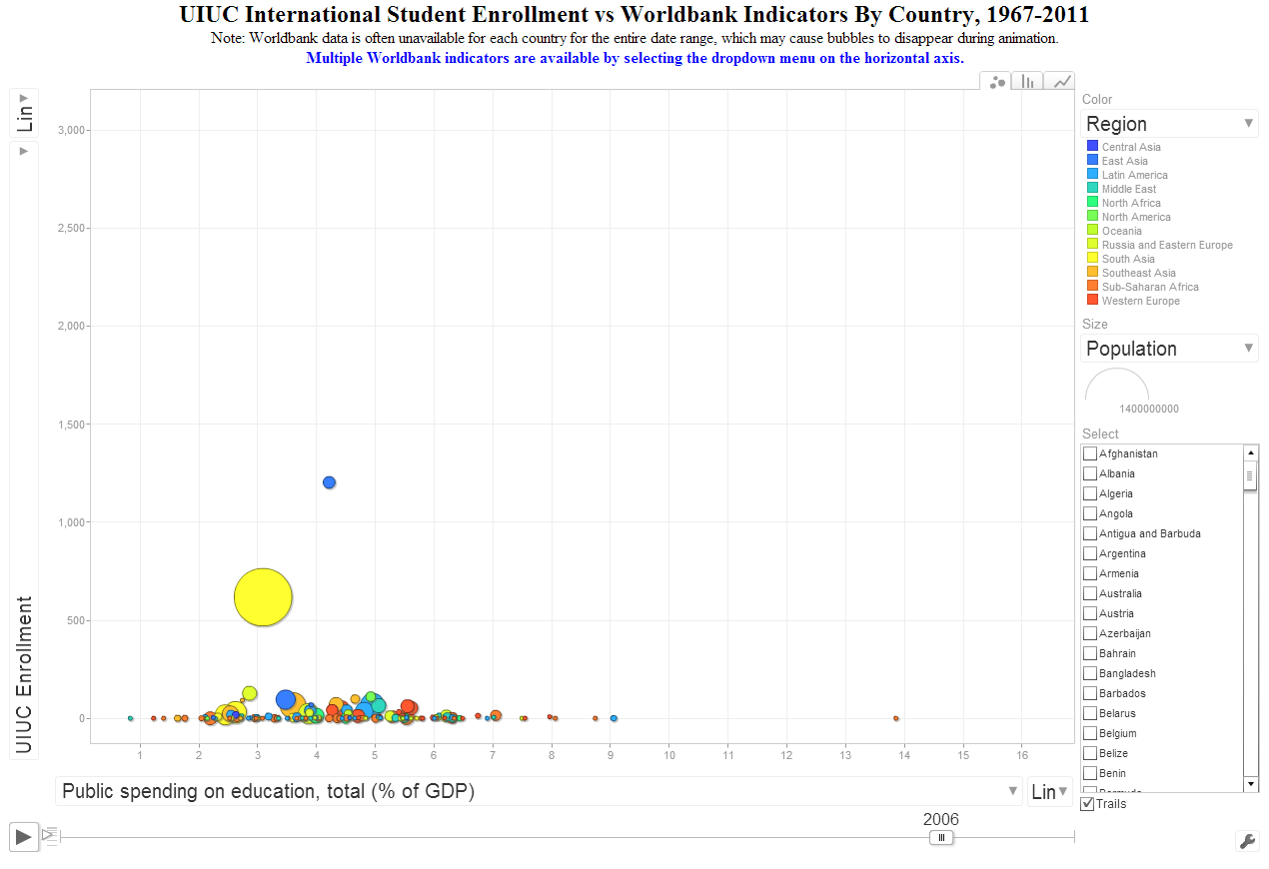
Notes:
We can go even a step further and try to use data visualization to help us make some predictions.
Following Hans Rosling’s lead, let’s look compare UIUC International Student Enrollment with various World Bank indicators.
-Starts out with GDP (current US$); let’s look at something a bit more interesting like Public spending on education as % of GDP. -Some of lowest spenders on education have highest enrollment; big blue circle=China. -Red circle bouncing around on x-axis in late 90’s-2000’s: Lesotho. 16% of GDP on education? Not leading to increase in intl enr. -Bubbles start popping when data disappears. -Doesn’t seem to be any real correlation here, but fun to watch.
Go to go.illinois.edu/dataviz after talk to play around with these World Bank indicators on your own.
Tableau can do something similar.

Slide 42
Data exploration dashboard
Notes:
Note: unavailable in powerpoint archive due to restrictions with distributing data displayed in dashboard

Slide 43
Conclusion
Struggle… struggle… struggle… breakthrough!
Experiment, but have a goal in mind
Iterative
There’s always room for improvement
Present visualizations early and often
Look to others for inspiration
Don’t reinvent the wheel
Notes:
Early visualizations are “cool”, but may hit the wall when it comes to “functional”
Paper sketches are useful
Sleep on it
Much like a web page, you’re never done

Slide 44
Thank you!
Feel free to contact either of us with Tableau-specific or general data visualization questions. Chris Lehman – calehman@illinois.edu Kim Nystrom – knystrom@illinois.edu
Slides and all interactive content from today available at: http://go.illinois.edu/dataviz

